Slide 1
Uber Demand-Supply Analysis

Slide 2
Problem Statement
Find out the pain points for Uber in terms of Demand-Supply gap by identifying the problematic time-slots and problematic type of requests.
Suggest ways to improve the situation and deal with the identified pain points.

Slide 3
Data Exploration
Dataset contains 6 columns
Request ID
Pickup Point
Driver ID
Status
Request Timestamp
Drop Timestamp
As per the problem statement, the columns of interest are pickup point, status and request timestamp.

Slide 4
Data Cleaning and Preparation
Possible issues in the data-set
Duplicate values of request ID
Missing values in the columns of interest
Request timestamp is not in date time format. It needs to be converted.
Date separator is not consistent (“/” and “-” have been used). It has to be made consistent.

Slide 5
Request Analysis by Status
The trend pattern of requests is common across
all 5 days.
Requests get “Cancelled” more in the morning hours than other hours during the day.
Requests aren’t fulfilled due to “No Cars Available” more in the evening hours than other hours during the day.
No of Requests

Slide 6
Request Analysis by Pickup Point
The trend pattern of requests is common across
all 5 days.
More City to Airport requests come during the morning hours than other hours during the day.
More Airport to City request come during the evening hours than other hours during the day.
No of Requests

Slide 7
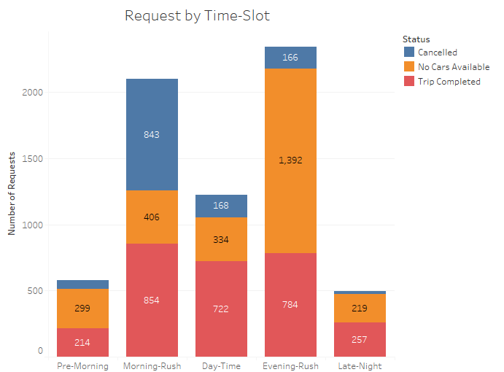
Request Analysis by Time-Slot
Hours | Time Slot
12 AM – 5 AM | Pre-Morning
5 AM – 10 AM | Morning-Rush
10 AM – 5 PM | Day-Time
5 PM – 10 PM | Evening-Rush
10 PM – 12 AM | Late-Night
This plot reaffirms the two major problems:
Cancelled trips during the morning rush
Unavailability of cars during the evening rush

Slide 8
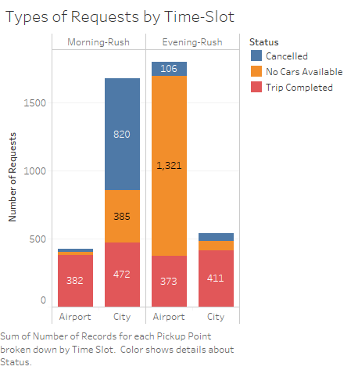
Problematic Time-Slots and Request Types
City to Airport request during Morning-Rush:
Demand = 1677 (820+385+472)
Supply = 472
Demand is ~3.5 times the supply
Also, ~50% requests get cancelled.
Airport to City requests during Evening-Rush:
Demand = 1800 (106+1321+373)
Supply = 373
Demand is ~4.8 times the supply
Also, No car is available for ~70% of the requests.

Slide 9
Recommendations
To tackle the issue of morning-rush cancellations for City to Airport rides, drivers can be incentivized to make those trips by taking the following measures:
They could be given a bonus for each city to airport trip they make during the morning-rush.
Uber can pay a part of the gas expenses for the return trip to city in case the driver doesn’t get a return trip request.
Uber can introduce offer for customers for airport to city rides to encourage them to book rides from airport which in turn will increase the demand at the airport and also reduce idle-time.
Increased marketing can also help in increasing the demand at the airport.
To tackle the issue of car unavailability (less number of drivers) during evening hours for the airport to city rides, following measures can be taken:
Drivers can be given extra bonus for any airport to city request they take during evening. This will increase the supply at the airport since more drivers will take city to airport trips to earn the bonus during the return trip.
Uber can introduce car-pooling from airport so that less number of cars can serve more customers.
Uber can pay the drivers to come to the airport without a passenger to the airport.

